Slide 1
A Data Journey - Introduction Buyer Propensity Model
March, 2018

Slide 2
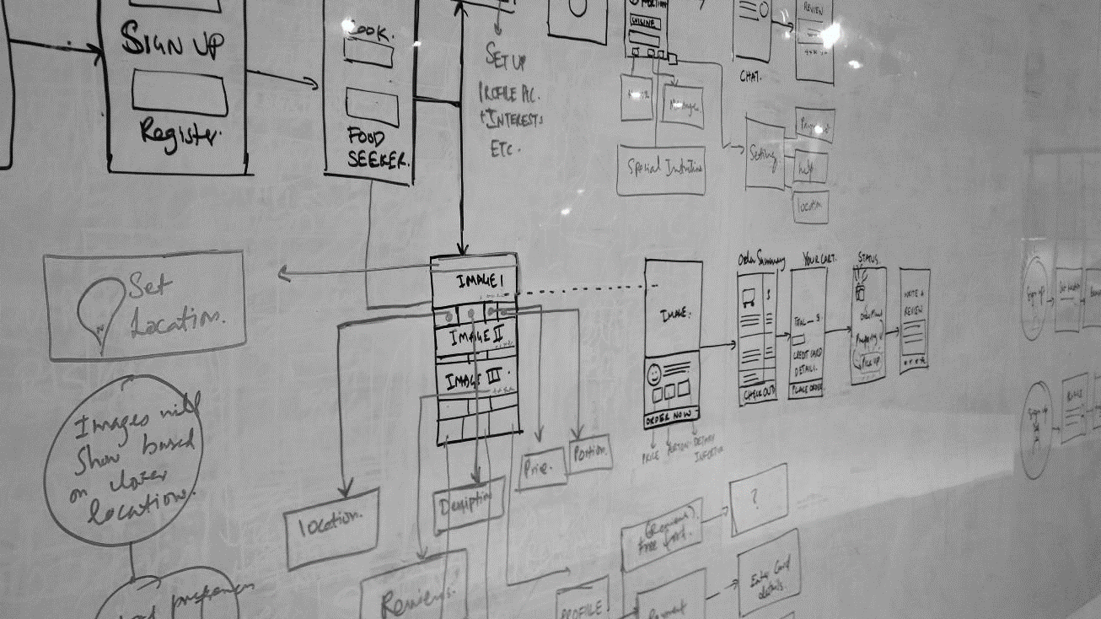
All elements in an experience are exchanges between people, brands, businesses, services, & increasingly, machine-powered intelligence.

Slide 3
Discussion
What’s This About?
Why Now?
Why Microsoft?
Example - Customer Selection
Take-Aways

Slide 4
5 Questions Data Science Answers
Data Science uses numbers and names (also known as categories or labels) to predict answers to questions. It might surprise you, but there are only five questions that data science answers:
Is this A or B?
Is this weird?
How much – or – How many?
How is this organized?
What should I do next?
Each one of these questions is answered by a separate family of machine learning methods, called algorithms.
Notes:
It's helpful to think about an algorithm as a recipe and your data as the ingredients. An algorithm tells how to combine and mix the data in order to get an answer. Computers are like a blender. They do most of the hard work of the algorithm for you and they do it pretty fast.

Slide 5

What’s This About?
This is about empowering your company to do more with what it already has

Slide 6

What’s This About?
Data is a Key Strategic Asset – Leverage It to Survive
$1.6T
10%
Additional business value captured by companies that are leaders in using data assets to their advantage
Source: IDC, 2014
Percent of organizations expected to have a highly profitable business unit specifically for productizing and commercializing their data by 2020
Source: Gartner, 2016
Notes:
Data is now the key strategic business asset. Everything that’s happening in the world around us - every purchase, upload, shipment, tweet, keystroke, sensor reading and customer interaction - is producing incredibly rich data that can help us create new experiences, new efficiencies, new business models and even new inventions.
Handling growing volumes of data is key, since there’s more and more of this strategic asset every day. IDC projects that the digital universe will double every two years between now and 2020, and will reach 20 zettabytes (ZB) by 2020. IDC also estimates there will be approximately 5,247 GB of data for every man, woman and child on earth in 2020.
Leveraging this data can be the differentiator for your business. For example, IDC estimates companies that are leaders in using data assets to their advantage will capture $1.6 trillion more in business value than those that lag behind. And Gartner predicts that by 2020, 10% of organizations will have a highly profitable business unit specifically for productizing and commercializing their data.
While data is pervasive, the key is being able to do something meaningful with it. Unfortunately, actionable intelligence from big data is often elusive. To gain actionable intelligence, you need a way to harness the power of massive amounts of data – to manage it, apply advanced analytics to it and gain insights from it. By taking advantage of advanced analysis techniques like predictive and prescriptive analytics, you can derive not just insight but foresight, and identify what actions should be taken in order to drive better outcomes. With this ability, you can move from seeing “what happened” and understanding “why it happened” to predicting “what will happen” and ultimately, knowing “what should I do.” This lets you move from manual, people-heavy decision-making to automated, machine-assisted decisions that accelerate business and aid competitive advantage.
-------------------------------------------
Statistics sources:
1) IDC projects that the digital universe will double every two years between now and 2020, and will reach 20 zettabytes (ZB) by 2020. IDC also believes there will be approximately 5,247 GB of data for every man, woman and child on earth in 2020
Source: EMC Digital Universe Study, with research and analysis by IDC. April 2014. http://www.emc.com/leadership/digital-universe/2014iview/index.htm
2) IDC estimates companies that are leaders in using data assets to their advantage will capture $1.6 trillion more in business value than those that lag behind.
Source: IDC White Paper | Capturing the $1.6 Trillion Data Dividend, Document #248459. © 2014 IDC | https://azure.microsoft.com/en-us/blog/announcing-cortana-analytics-suite-and-new-partner-investments-at-wpc-2015/?WT.mc_ID=NEWS_EPG_Spain_SEP15
3) Gartner predicts that by 2020, 10% of organizations will have a highly profitable business unit specifically for productizing and commercializing their data
Source: http://www.gartner.com/binaries/content/assets/events/keywords/business-intelligence/bi10a/biaim-summit-2016_gartner-opening-keynote.pdf

Slide 7
What’s this About?
Get Ahead of the Competition
Improving visibility and making accurate predictions with remote monitoring
Getting the right products to the right places with inventory management
Offering customers exactly what they want, when they want it, with personalization
Fixing problems proactively before they start with predictive maintenance
Exploring new business opportunities with data-driven services
What this presentation explores
Notes:
Getting ahead by leveraging Big Data, the cloud and intelligence can take a number of forms.
If you’re interested in gaining some of that $1.6 trillion in business value by leveraging data assets, it starts with understanding the data your organization has and what it can be used for.
These can be a useful starting point as you consider how your organization could benefit.
Here are a few examples of what companies are doing to stay ahead:
They are gaining better visibility into their businesses and making better predictions
In manufacturing, this can involve using remote monitoring to know exactly what’s going on with equipment at customer sites or in remote locations
In retail, this involves optimizing demand forecasting to better predict what customer demand will look like next season, or next year.
In financial services or other areas where risk-mitigation is needed, it might involve pinpointing signs of fraud more effectively
They are using advanced analytics to ensure materials, parts and products are optimally distributed to the right places at the right times
In manufacturing, this may involve optimizing the supply chain, making sure parts are on hand in the right warehouses and at the right suppliers given historical patterns
In retail, this involves more precisely managing inventory and ensuring it goes to the right place the first time, which preserves margins by reducing the need to ship inventory elsewhere. If a customer looks at a product online, then comes into a store to purchase it, the retailer can have advance warning and be prepared with the item in stock (or know where it is in a nearby store)
These are both examples of better optimizing the marketing mix – using advanced analytics and intelligence to ensure the right product is in the right place, at the right price
Across industries, getting the right items to the right places contributes to operational efficiency objectives
Offering customers what they want, when they want it, using advanced analytics to develop deep, 360-degree view of customers and deliver personalized experiences
In manufacturing, this may involve tracking a customer’s use of a particular product, identifying wear patterns, offering advice on how to make the product last longer, and offering targeted promotions on replacement parts. This enables manufacturers to anticipate what customers need before they even ask.
In retail, this can involve tracking every customer interaction and purchase, whether in-store, online, via social media, via a mobile app or other channels. Assembling a picture of the customer in this way helps retailers better predict what customers are looking for, and can offer targeted promotions and offers.
In financial services, this might involve making more tailored product recommendations based on customer information from across channels - from detailed demographics to social media interactions.
Across industries, using data, advanced analytics and intelligence capabilities can support more successful new product introduction. With these technologies, you can reduce the likelihood of introducing products that flop by informing product development with data and analytics.
Fixing problems proactively, before products and equipment ever break down
Across many industries, this can involve starting predictive maintenance programs – whether that’s for your own equipment, assets or facilities, or for products installed at customer sites
Across many industries, getting problems proactively handled can support operational efficiency gains – it’s usually cheaper, faster and easier to prevent a problem than to fix it after the fact. Whether you’re talking about chronic disease care or expensive equipment at a manufacturing site, the principle is the same.
Across many industries, customer service improvement as a result of advanced analytics and big data is an example of fixing problems proactively before they start. For example, if you’re a cable provider, and you know there have been service quality problems for a certain customer, you can proactively, automatically offer them a discount, and notify them that you are working on the problem, and offer a target resolution time. This could prevent them from calling into your call center multiple times, and may even prevent them from switching to another firm.
Building data-driven service offerings, such as delivering products-as-services or packaging data for commercial sale
In any industry offering physical products, this might involve offering products as services. Instead of a single transaction where a product is exchanged, the product is automatically serviced and updated, maintaining the relationship with the customer and creating opportunities for cross-sell and upsell.
In manufacturing, using advanced analytics and big data to identify typical wear patterns and next-logical-purchases, firms can offer targeted promotions on replacement parts as well as complementary products
These are just a few of the many examples out there. Other examples include real-time recommendations, better customer acquisition, optimized loyalty programs and lifetime customer value, customer churn forecasting, fraud detection, pay for performance, more accurate product segmentation, better pricing strategies and many more.

Slide 8
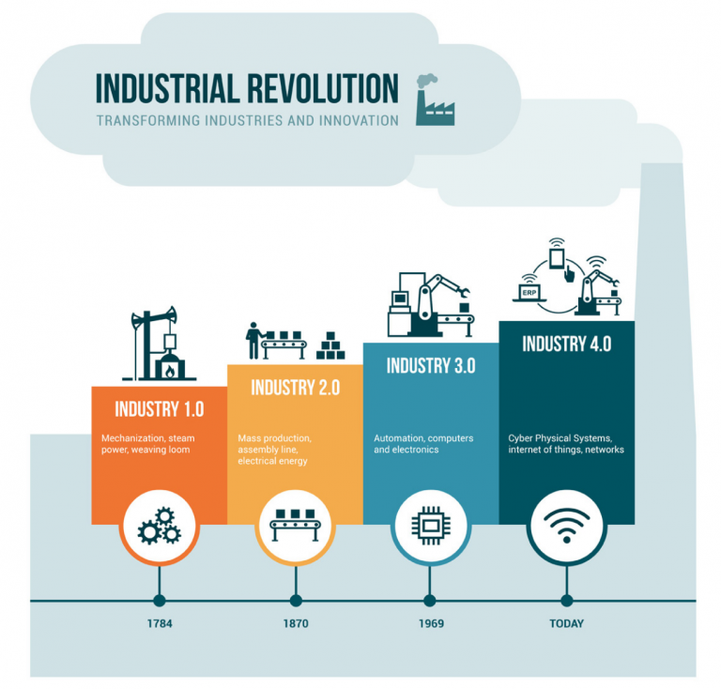
We are living in the era of the 4th industrial revolution
Why Now?
Notes:
At certain points in history, advancements in technology fundamentally disrupt the economic landscape. Some of history’s biggest revolutions occurred as a direct result of innovative technological developments. In the face of these disruptions, adapting is the key to survival and growth. Those who adapt successfully often emerge stronger than before. Those who don’t risk becoming obsolete.
For example, the industrial revolution that started in about 1760 resulted from technological advancements that supported iron production and enabled commercial use of steam power. Factory systems emerged to replace manual production, output per worker increased dramatically, and industry thrived where it had been stagnant for years. And of course, this environment really favored innovators
Starting over a century later in approximately 1870, a second industrial revolution introduced systems like electrical power, gas, water and telegraph lines.
More recently, the world saw the rise of a third revolution – one you’re probably the most familiar with – which is often called the digital revolution. Believe it or not, the seeds of this revolution started cropping up in the 1950s, roughly 40 years after the second revolution ended. However, the peak of the third revolution wasn’t until several decades later. This revolution was driven by the rise of digital computers and the internet. As these technologies became widespread, it enabled information to be generated and shared faster and more easily, opening up new possibilities for economic, social, and technological innovation.
Why is this context relevant? For two reasons. One, there is less and less time between these revolutions. Technological changes are happening more rapidly, and the window of time that companies have to adapt is shrinking. Two, we’re facing another technological disruption today – so the principle of “adapt or get left behind” should be top of mind.

Slide 9




Why Now? The Era of the 4th Revolution
We won’t experience 100 years of progress in the 21st century — it will be more like 20,000 years of progress. Kurzweil 2001
Digital
Revolution
Machines replace knowledge work.
Industrial
Revolution
Machines replace repetitive & tedious work.
Industrial
Revolution
Machines replace dangerous & heavy work
19th Century
20th Century
21st Century
Notes:
We are living in the era of the 4th industrial revolution
At certain points in history, advancements in technology fundamentally disrupt the economic landscape. Some of history’s biggest revolutions occurred as a direct result of innovative technological developments. In the face of these disruptions, adapting is the key to survival and growth. Those who adapt successfully often emerge stronger than before. Those who don’t risk becoming obsolete.
For example, the industrial revolution that started in about 1760 resulted from technological advancements that supported iron production and enabled commercial use of steam power. Factory systems emerged to replace manual production, output per worker increased dramatically, and industry thrived where it had been stagnant for years. And of course, this environment really favored innovators
Starting over a century later in approximately 1870, a second industrial revolution introduced systems like electrical power, gas, water and telegraph lines.
More recently, the world saw the rise of a third revolution – one you’re probably the most familiar with – which is often called the digital revolution. Believe it or not, the seeds of this revolution started cropping up in the 1950s, roughly 40 years after the second revolution ended. However, the peak of the third revolution wasn’t until several decades later. This revolution was driven by the rise of digital computers and the internet. As these technologies became widespread, it enabled information to be generated and shared faster and more easily, opening up new possibilities for economic, social, and technological innovation.
Why is this context relevant? For two reasons. One, there is less and less time between these revolutions. Technological changes are happening more rapidly, and the window of time that companies have to adapt is shrinking. Two, we’re facing another technological disruption today – so the principle of “adapt or get left behind” should be top of mind.

Slide 10
Why Now?
Time to Adapt & Change is Shrinking
A hundred years ago, the average lifespan of a company listed on the S&P 500 index was 67 years
In the 2020s…
75% of the S&P 500 will be new (not on the index today)
25% of the S&P 500 will
be ones on the index today
Source: BBC
Notes:
Compared to the past, what’s unique about the disruption happening today is the rapid pace of change. During past revolutions, firms had many years, even decades, to adapt. Today, that is no longer the case. One indicator of just how fast the landscape is changing is the longevity of companies on the S&P 500, an index of leading US companies.
Roughly a hundred years ago, the average lifespan of a company listed on the S&P 500 was 67 years. Today, that average lifespan of a company on the S&P 500 has decreased to just 15 years. This demonstrates that it is becoming harder for companies to stay in the lead, or even in business, for very long.
Experts believe that we’ll see this trend continue. Richard Foster, a Yale University professor and former McKinsey partner, predicts that in the next decade, only 25% of the companies currently listed on the S&P 500 will remain there, meaning the other 75% will be replaced by new companies. These new companies will be those that take advantage of innovative technological capabilities to rapidly gain ground in their chosen markets. Similarly, the existing companies that remain on the index will be those that rapidly innovate and evolve their businesses.
The bottom line is, today’s organizations must adapt quickly to change, using new technologies that fuel competitive advantage, or risk getting left behind. That’s why it’s imperative to make the most of big data, the cloud and intelligence capabilities, all of which help companies accelerate their speed of business through smarter decision-making and faster execution.
<Transition>: Let’s talk about some examples of what Microsoft customers are doing to transform.
-------------------------------------------
Statistics source:
BBC, 2012, quoting Richard Foster - http://www.bbc.com/news/business-16611040
"The average lifespan of a company listed in the S&P 500 index of leading US companies has decreased by more than 50 years in the last century, from 67 years in the 1920s to just 15 years today, according to Professor Richard Foster from Yale University. Professor Foster estimates that by 2020, more than three-quarters of the S&P 500 will be companies that we have not heard of yet."

Slide 11
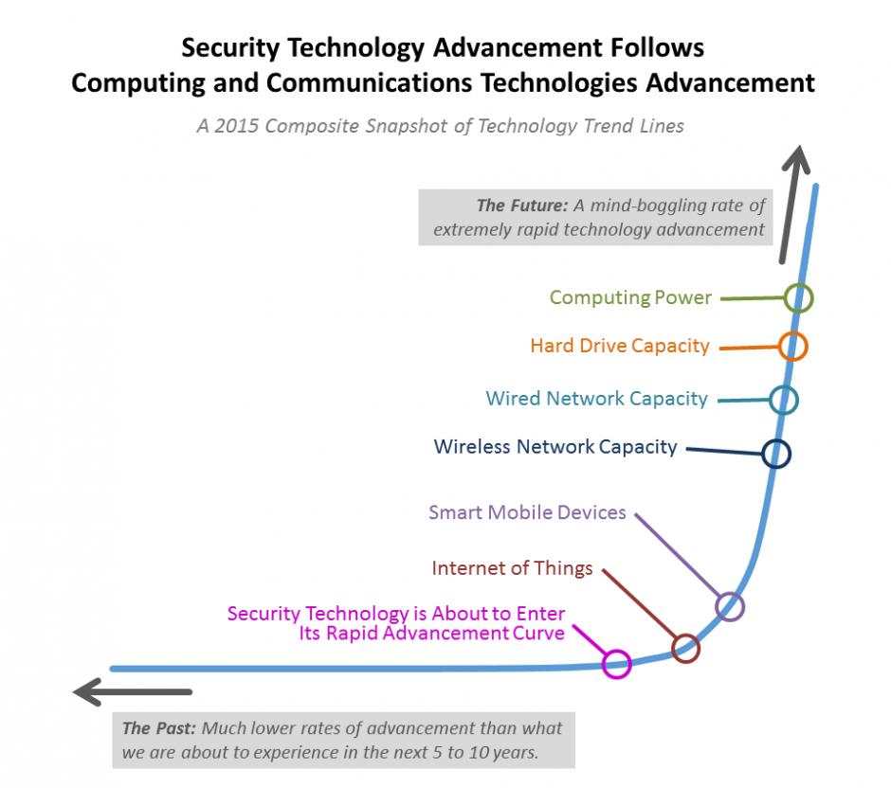

Slide 12
Why Now ? Digital Transformation
Everyone talks about this but what does it really do for me?
Intelligent Systems
Transform Products & Services
Operations Optimization
Employee Empowerment
Customer Engagement

Slide 13
Why Microsoft?
Microsoft is the Leader in AI Tools and Development
2018 GARTNER MAGIC QUADRANT for Analytics and Business Intelligence Platforms
Microsoft CEO Satya Nadella formed the Microsoft AI and Research group as a fourth engineering division at the company, alongside the Office, Windows and Cloud & Enterprise divisions.
AI and Research group has grown by 60 percent — from 5,000 people originally to nearly 8,000 people today
Only provider of end-to-end solutions and comprehensive AI Platform

Slide 14
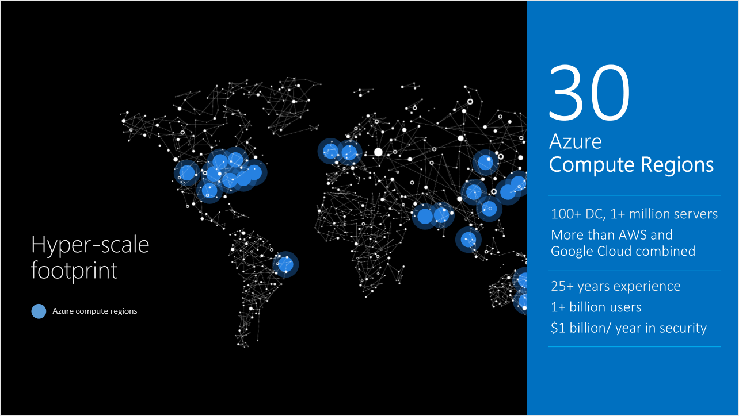
Why Microsoft?
Notes:
No one can scale and provide all the tools from the customer experience to the backend processing and ERP systems while providing predictive analytics during the entire path.

Slide 15



Why Cloud?
Speed
Scale
Economics
Reduce time to develop
Accelerate time to market
Enable business flexibility
Drive new growth
Self-service, on demand
Elastic scalability
“Unlimited” compute capacity
Global reach
Pay as you go
No CapEx
Less wasted capacity
Billing and Chargebacks

Slide 16
Example – Customer Selection
Use Case
You sell bikes. You have a limited marketing budget. How do you maximize the value of the marketing spend?
Identify customers most likely to make a purchase within a predetermined time frame
Concentrate on those prospective customers
Increased sales allows you to customize other marketing efforts on the other propectives customers in a systematic, data driven way.
Notes:
Uses a range of Microsfot technologies including Azure Data Catalog, Azure Data Factory, BLOB Storage, AzureML and Power BI

Slide 17
DEMO
Summary
This is a buyer propensity model that predicts which customers are most likely to buy bikes. This is a good example of a customer targeting model that is widely used in Marketing. It uses 2 binary classification algorithms namely Logistic Regression and Boosted Decision Trees.
**Inputs:**
The input data is the BikeBuyer dataset that has historical sales data on a set of fictitious customers. This data includes demographic variables such as marital status, gender, yearly income, number of children, occupation, age, etc. Other input variables include home ownership status, number of cars, and commute distance.
**Outputs:**
The training data has one output - a single binary variable showing whether the customer bought a bike or not. The output of the model is the probability of purchase. So for a given customer the model shows the probability that the given customer will buy a bike.
Notes:
Demo Power BI dashboard.

Slide 18
Take-Aways
Unique time in history
4th Industrial Revolution
Speed of change accelerating exponentially
Change or die
Data exploration and exploitation is the lifeline
Valorem can lead you to the digital revolution

Slide 19
THANK YOU
Q & A

Slide 20
A Data Journey – Deep Dive Buyer Propensity Model
March, 2018

Slide 21
Discussion
Use Case Review
Technologies & Tools
Solution Walkthrough

Slide 22
Use Case
Propensity Model

Slide 23



At-risk customers
Empowered Agents
Segmentation Model
High-value Customer Agents
Calls Company
CM
SM
PM
Propensity Model
Churn Model
Other Agents

Slide 24
Use Case – Business Problem Propensity Modeling
A marketing manager for a bike manufacturer has a limited budget to run a mailing campaign. To maximize ROI, the marketing manager wants to send the campaigns to buyer most likely to make a purchase.
Inputs:
Sales transaction data about customers that bought bikes in the past
Data from previous marketing campaigns showing which customers were targeted and whether they responded
Consumer lists from a 3rd party with demographic and credit history
Outputs:
The output of the model shows the probability that the given customer will buy a bike.

Slide 25
Technology & Tools
Propensity Model

Slide 26
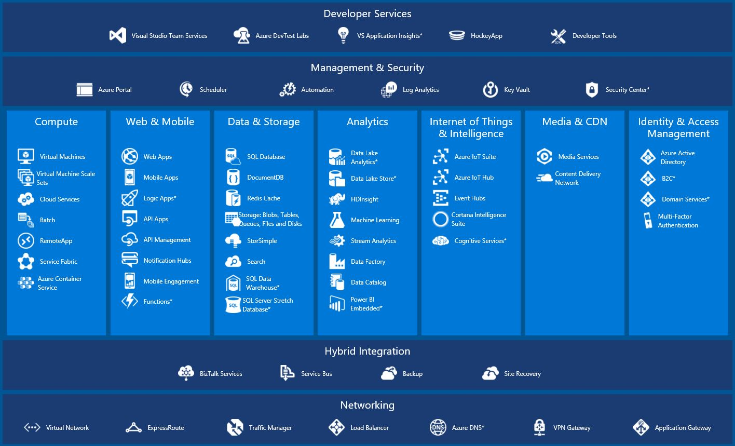
Notes:
Power BI – Yes; Embedded - No

Slide 27
The Microsoft AI platform
AI SERVICES
AI TOOLS
CONVERSATIONAL AI
TRAINED SERVICES
CUSTOM SERVICES
Bot Framework
Cognitive Services
Azure Machine Learning
CODING & MANAGEMENT TOOLS
VS Tools for Machine Learning
Azure ML Studio
Azure ML Workbench
AI INFRASTRUCTURE
Others (Pycharm, Jupyter notebooks…)
AI ON DATA
AI COMPUTE
DEEP LEARNING FRAMEWORKS
Cosmos DB
SQL
DB
SQL
DW
Data Lake
Spark
DSVM
Batch AI
ACS
Edge
Cognitive Toolkit
TensorFlow
Caffe
CPU, GPU, FPGA
Others (Scikit-learn, MXNet, Keras, Gluon…)

Slide 28
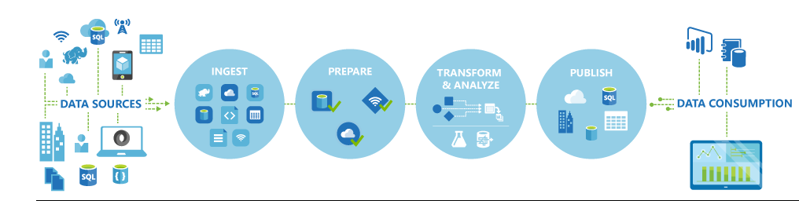
Propensity Model Architecture
We will use:
Azure Data Catalog
Azure Data Factory to retrieve on-premises data
Store the data on Azure Storage Blob
Ingest data from Azure Blob into AzureML
Create a predictive model and operationalize it through an API
Consume the API in Excel and Power BI

Slide 29
DEMO
Summary
This is a buyer propensity model that predicts which customers are most likely to buy bikes. This is a good example of a customer targeting model that is widely used in Marketing. It uses 2 binary classification algorithms namely Logistic Regression and Boosted Decision Trees.
**Inputs:**
The input data is the BikeBuyer dataset that has historical sales data on a set of fictitious customers. This data includes demographic variables such as marital status, gender, yearly income, number of children, occupation, age, etc. Other input variables include home ownership status, number of cars, and commute distance.
**Outputs:**
The training data has one output - a single binary variable showing whether the customer bought a bike or not. The output of the model is the probability of purchase. So for a given customer the model shows the probability that the given customer will buy a bike.

Slide 30
Demo Setup
Propensity Model

Slide 31
Setup/Prep Requirements
Start DSVM on Azure DI Subscription
Check to see if Integration Runtime is working (shortcut on desktop)
Public IP: 40.76.18.186
Using the Azure Portal, ensure czwADF1 Pipeline is working

Slide 32
Demo – Detailed Steps
Search for interesting data in data catalog
Open Azure Data catalog app on laptop and search for bike https://use-su1.azuredatacatalog.com/#/home
Show the columns in the CSV
Note that cweaver@valorem is the person to contact for access
Go to Azure portal and open Blob storage
Note that the data could be downloaded by the Download link or the URL
Introduce Data Factory to show how the data gets into Blob (recall the data comes from the DSVM VM, not the laptop!)
Recall the VM must be running (verify the Integration Runtime is enabled)
Data is in the czwdemo container
DSVM should be running. Make sure Integration Runtime is status green

Slide 33
Demo – Detailed Steps, Cont’d
Open AzureML Studio https://studio.azureml.net/
Open Buyer Propensity Model-US
Note that the data is retrieved directly from the Azure Blob storage
Briefly review the AzureML Model – visualize the performance
Show Predictive Experiment tab
Mention it is created automatically. Only mod was the selection of output variables
Go to Web Services and select Buyer Propensity Model – US [predictive exp]
Show the Test Button but do not execute (just to save time)
Open the Excel 2013 or Later link (enable editing when prompted)
Use Sample Data. Select N1 as Output (ensure Include headers is selected)
Go to Azure Blob czwdemo and download BikeBuyerRandomTestData.csv.
Copy the random data into the Excel Algorithm file and run the prediction (note, Excel seems to hang – give it a minute – it’ll free up!) Move to PBI

Slide 34
Demo – Detailed Steps, Cont’d
Open BikeBuyer PBI File
Highlight the data on the dashboard where the scored probabilities from the Excel file are illustrated
Note the fields are the same that we saw throughout the demo
Started at Data Catalog, through Data Factory, Azure Blob, AzureML, Excel and finally into Power BI

Slide 35
AzureML
Building the model

Slide 36
AzureML – Propensity Model Demo
Model Development
Classification typically start with logistic regression
Boosted tree have become more common
Compare Models
AzureML Evaluate Model provides a number of useful metrics
Accuracy, AUC, F1 and more
Accuracy measures how well the model correctly identifies buyers and non-buyers
Because of class imbalance, propensity models should not be evaluated on accuracy
Most of the records represent non-buyers. A model could simply always predict 0 for non-buyer and be right 90% of the time!
Area Under the Curve (AUC) and F1 are much better metrics when the data is imbalanced
Notes:
Log10 – remember to configure the results in place

Slide 37
AzureML – Propensity Model Demo
Model Results
Model | Data Split | Feature Selection | Accuracy | AUC | F1
Boosted Tree | Split | ✓ | 91.9% | 79.4% | 0.432
Boosted Tree | Split |  | 92.3% | 85.3% | 0.481
Boosted Tree | Cross Validated |  | 90.8% | 83.8% | 0.454
Logistic | Split |  | 91.4% | 67.7% | 0.032
Notes:
Log10 – remember to configure the results in place
Feature Selection did not work – likely because there were not that many variables.

Slide 38


What we learned
Azure Data Factory used to collect local data
Store data on Azure Storage
Use cloud data to build a predictive model
Deploy predictive model and an API
Consume the API in Excel
Leverage Power BI to democratize the results from machine learning investments
©Valorem

Slide 39
THANK YOU
Q & A

Slide 40
A Data Journey - Introduction Customer Churn Model
March, 2018

Slide 41
Churn Model
How did we do it?

Slide 42
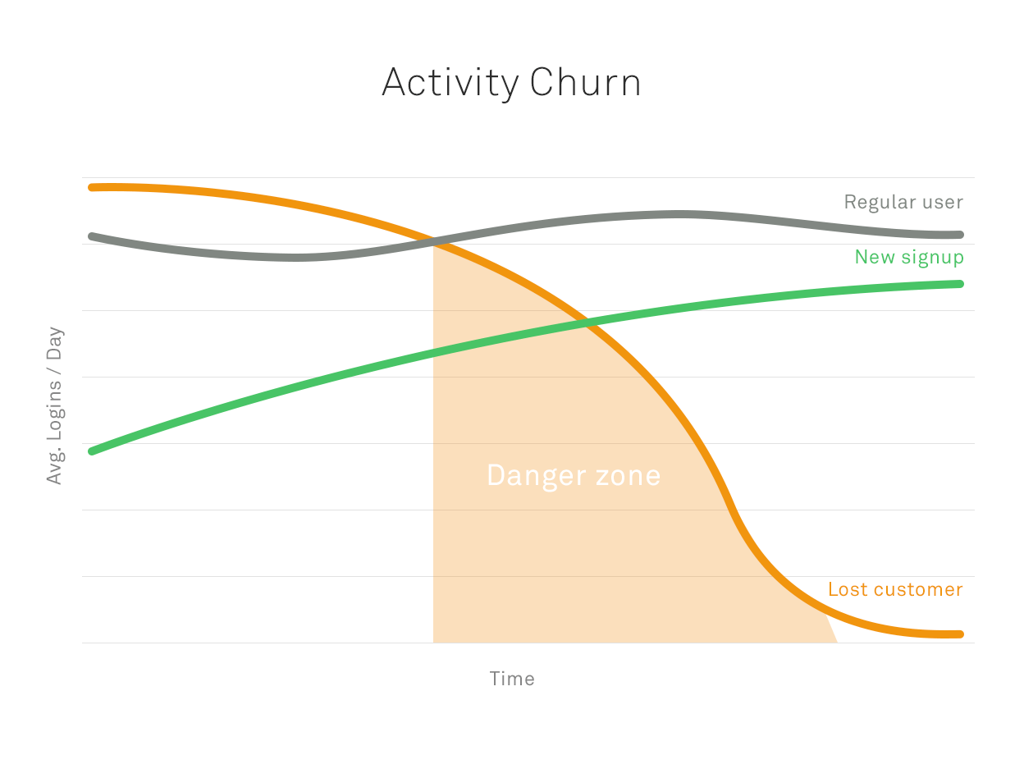
Notes:
http://businessforecastblog.com/whats-the-lift-of-your-churn-model-predictive-analytics-and-big-data/

Slide 43
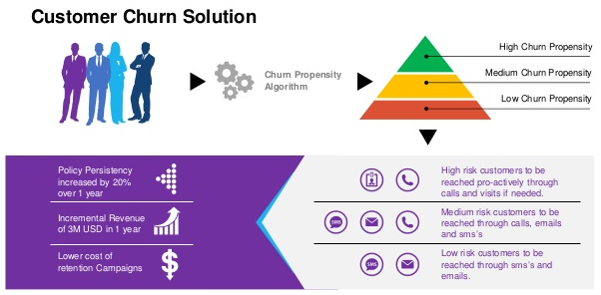

Slide 44
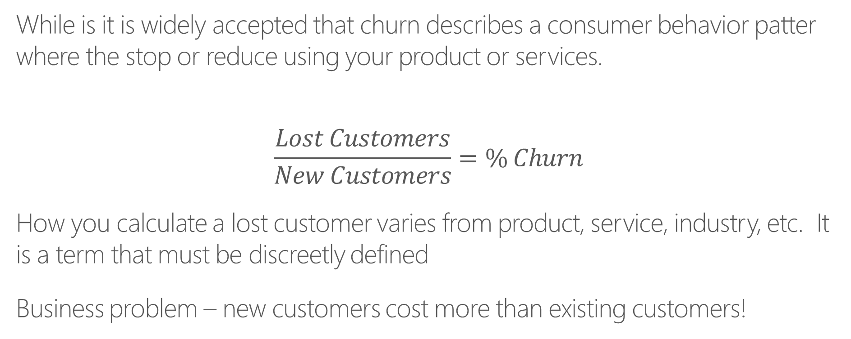
AzureML – Churn Model Demo
While is it is widely accepted that churn describes a consumer behavior patter where the stop or reduce using your product or services.
$$\frac{Lost Customers}{New Customers}=\% Churn$$
How you calculate a lost customer varies from product, service, industry, etc. It is a term that must be discreetly defined
Business problem – new customers cost more than existing customers!
Notes:
Churn definition see http://customer-churn.com/

Slide 45
Churn Model – Use Case
Data selected from 2009 KDD competition
The data was collected from a telecommunications company, Orange in France.
The goal is to build an effective machine learning model for predicting churn, willingness to buy new products/services and opportunities for upselling.
In this exercise we focus on customer churn.
Notes:
KDD Cup is the annual Data Mining and Knowledge Discovery competition organized by ACM Special Interest Group on Knowledge Discovery and Data Mining, the leading professional organization of data miners. (SIGKDD)
The Association for Computing Machinery (ACM) is widely recognized as the premier membership organization for computing professionals, delivering resources that advance computing as a science and profession; enabling professional development; and promoting policies and research that benefit society.

Slide 46
AzureML – ChurnDemo
Data Engineering
Columns 1-190 are numeric, the rest are categorical.
Split the data between numeric and categorical
Remove numerical variables that are all or nearly all 0s (added a branch showing how to do this in R)
Apply a Math operation to add +1 to each numeric variable
Allows you to distinguish between a 0 in the data source vs. the substitution value of 0 when the missing data substitution is made later.
Apply the Clean Missing Data module to sub 0 for all missing numeric values
Bin the numeric column variable values into 50 equally spaced bins
This sometimes helps the accuracy of machine learning algorithms – always experiment to determine the best way to proceed!
Notes:
Get data here: http://www.kdd.org/kdd-cup/view/kdd-cup-2009/Data
Data file name : orange_small_train.data

Slide 47
AzureML Churn Demo
Categorical Data
Use Clean Missing Data to replace missing data with 0
Use Edit Metadata to ensure all categorical variables have the data type Categorical
Join Data
Combine the numerical and categorical columns together using Add Columns.
Add labels variable to combined dataset
A file consisting of one column with values of -1 (did not churn) and +1 (customer churned)
Change the name of the label from Col1 to ChurnLabel

Slide 48
AzureML Churn Demo
Algorithm Development
2 classification algorithms are evaluated
Two Class Boosted Decision Tree and Two Class Decision Forest
Split the data into test and train
Run the models and review the results
Notes:
The key difference between the 2 models is:
In boosted decision tree algorithms multiple decision trees are grown in a series such that the output of one tree is the input to the next tree (boosting approach to modeling)
Decision Forest algorithm grows each decision tree independently of one and other. Each tree in the ensemble uses a sample of data drawn from the original dataset. (Bagging approach of ensemble modeling)

Slide 49
Business Problem
How can I improve my business?

Slide 50
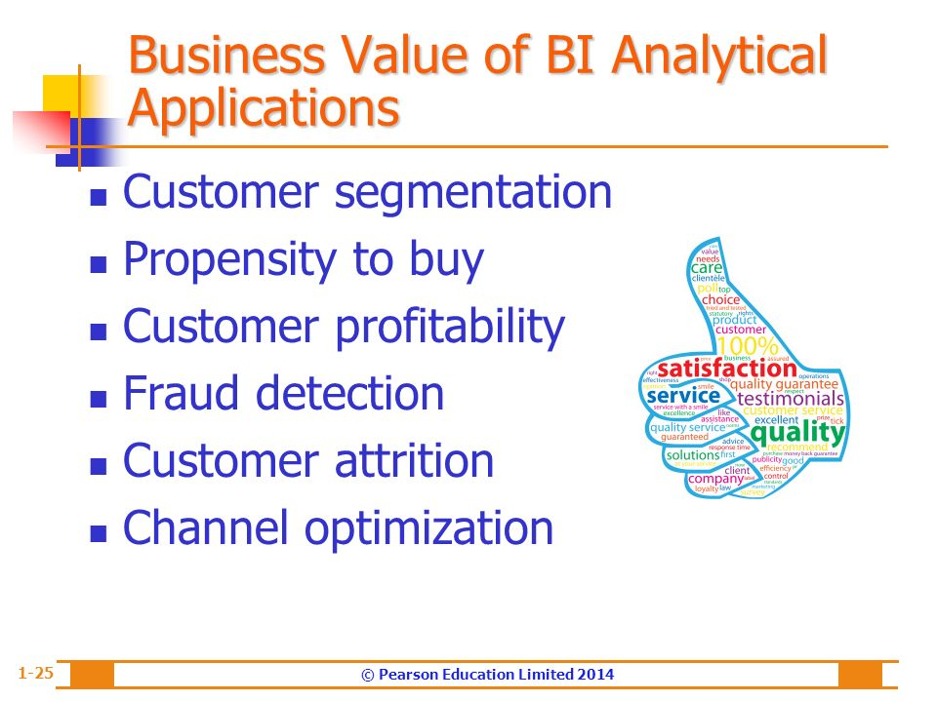

Slide 51
THANK YOU
Cliff Weaver
Data Scientist
cweaver@valorem.com
(816) 406-1501

Slide 52
My Notes
Data questions to always ask:
What kind of information is captured in each column?
How specifically is each variable captured?
Are missing values high informational content?
Are the outliers meaningful or data entry errors?
Should the variables be used as provided or should new variables be derived from the given data?
What is the distribution or each variable values?
Numeric, ordinal or categorical? If categorical, are there industry standards that groups this data?

Slide 53
Reference

Slide 55
The Microsoft AI platform
AI SERVICES
AI TOOLS
CONVERSATIONAL AI
TRAINED SERVICES
CUSTOM SERVICES
Bot Framework
Cognitive Services
Azure Machine Learning
CODING & MANAGEMENT TOOLS
VS Tools for Machine Learning
Azure ML Studio
Azure ML Workbench
AI INFRASTRUCTURE
Others (Pycharm, Jupyter notebooks…)
AI ON DATA
AI COMPUTE
DEEP LEARNING FRAMEWORKS
Cosmos DB
SQL
DB
SQL
DW
Data Lake
Spark
DSVM
Batch AI
ACS
Edge
Cognitive Toolkit
TensorFlow
Caffe
CPU, GPU, FPGA
Others (Scikit-learn, MXNet, Keras, Gluon…)

Slide 56

AI services
Bot framework
Spider
Accelerated development for conversational AI
Cognitive Services
Broad range of trained services with customization for any scenario
Azure Machine Learning
Experimentation and management services for creating AI models with productivity

Slide 57

Cognitive Services
Vision
Language
Speech
Search
Knowledge
Computer Vision
Face
Content Moderator
Emotion
Video
Custom Vision
Video Indexer
Translator Text
Bing Spell Check
LUIS
Web Language Model
Text Analytics
Linguistic Analysis
Bing Speech
Translator Speech
Speaker Recognition
Custom Speech
Bing Autosuggest
Bing Image Search
Bing News Search
Bing Video Search
Bing Web Search
Bing Custom Search
Bing Entity Search
Recommendations
Knowledge Exploration
Entity Linking
Academic Knowledge
QnA Maker
Custom Decision

Slide 58
The Avanade Modern Analytics Platform (AMAP) Enabling Outcomes
Traditional Approach
The AMAP Approach
Pressure is on to realize results
Challenges
Outcomes
Innovate & Accelerate Insights
Innovate & Accelerate Insights
Combine real-time and advanced analytics with existing systems and data
Advanced Analytics
to
Accelerate Insights
Self-Service & Discovery
Data Management
Bridge the skills gap on advanced techniques
and
Augment your Talent Pool
Big Data/IOT/’Streams
Staying out front
...Meanwhile
customer needs
are changing
Develop & Design Experiences
Provide the business the data and analytics platform capabilities
Deliver Digital Platforms
to
Ready on Demand
Support & Enablement
Hire / Train People
XX
Manage upkeep and running of existing systems
Answer Business Questions
and
Buy Hardware & Software
AMAP Managed Services
Quick and Comprehensive
Set Strategy, Goals & Questions
Set Strategy, Goals & Questions
© 2016 Avanade Inc. All Rights Reserved.
58

Slide 59
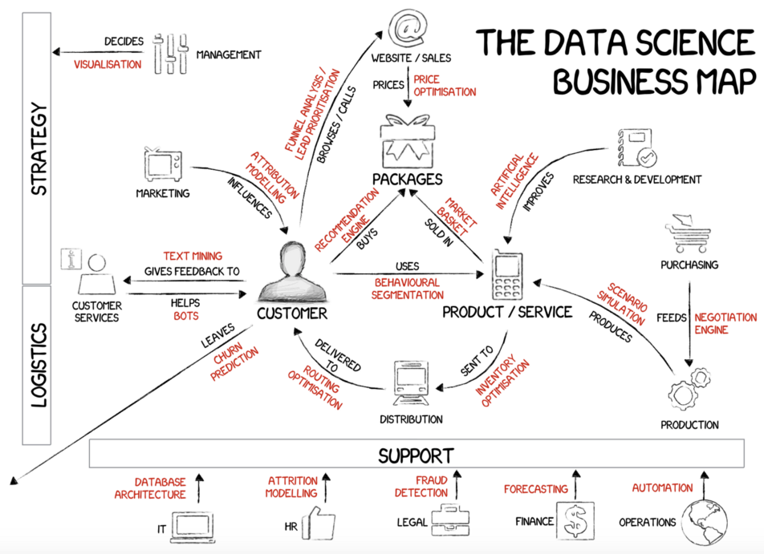
Notes:
From https://applied-data.science/solutions/

